Slide 1

Connecting non-data Literate Stakeholders to Data using R and Shiny
A case study using Cardiovascular Disease
By Cathrine Lind

Slide 2
Raw data
Collected from 3 databases (UCI) and Kaggle:
Hungarian Institute of Cardiology, Budapest
V.A. Medical Center, Long Beach, CA
University Hospital, Zurich, Switzerland
Cardiovascular Disease dataset
Notes:
Ungarn, Californien and Schweiz
- patients has undergoed angiography
- data is from UCI repository
Tidy principles: 1. Each variable forms a column.
2. Each observation forms a row.
3. Each type of observational unit forms a tab

Slide 3
Hungarian, Long Beach and Switzerland
Same cleaning steps for all three
From .data to .txt files
Split line by ‘name’ (e.g. former name of patient)
Reduced from 76 to 9 variables
All converted to numeric
Added 3 variables as factor versions of sex, fbs and cp
Notes:
OBS: These 3 are cleaned the exact same way
NA values are represented by ‘-9’
‘name’ was a dummy variable put into the database data
Variable chosen based on University in California Irvine and scientific paper.

Slide 4
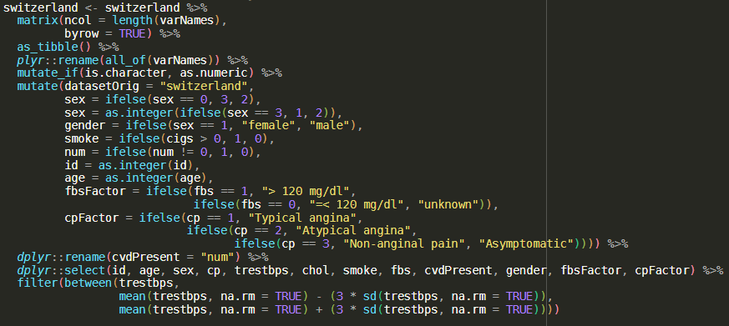

Slide 5
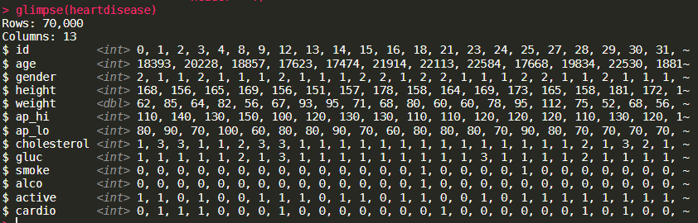
Cardiovascular Disease dataset
Contained 13 variables, where as 9 is kept and 3 is added: sex, bmi and ap_mean
More clean than the other data sets
Notes:
In generel the work load here has been on trying to match the columns across the datasets with each other in order to combine them later.

Slide 6
Database data
Combined data
id
age
sex
gender
cp
trestbps
chol
smoke
fbs
cvdPresent
id
age
sex
gender
height
weight
ap_hi
ap_lo
ap_mean
chol
alco
bmi
cvdPresent

Slide 7
The Shiny application

Slide 8
The Shiny application
Followed Mastering Shiny book
Created a shiny with top level navigation bar to toggle 4 different taps:
Data information
About cardiovascular disease (CVD)
The data
Pre-processing
Data
Visualization
Models

Slide 9
The Shiny application
fluidPage() + navbarPage()
navbarMenu()
tabPanel()
sidebarLayout()
sidebarPanel()
mainPanel()
Notes:
Der er en ydre fluidpage der skaber et miljø for HTML og CSS kode, hvorefter navbarPage bliver startet. Det er i navbarPage at titel, tema og navbarMenu bliver defineret. For hoveddelen af de tabs i navigations baren, der bliver lavet er oprettet som tabPanels, hvor man kan blive på ‘siden’ men skifte mellem eks. plots. Og for hver af disse plots er der en specifik sidebarPanel og en mainPanel.

Slide 10
Styling of the Shiny
1
Used the library fresh for creating custom Bootstrap theme
Main colors used:
1. https://dreamrs.github.io/fresh/index.html
Notes:
Fresh fungerer med fluidPage eller navbarPage
Her kan man angive farver og tema for tabeller, knapper, navbars, tekst etc.
https://dreamrs.github.io/fresh/index.html

Slide 11
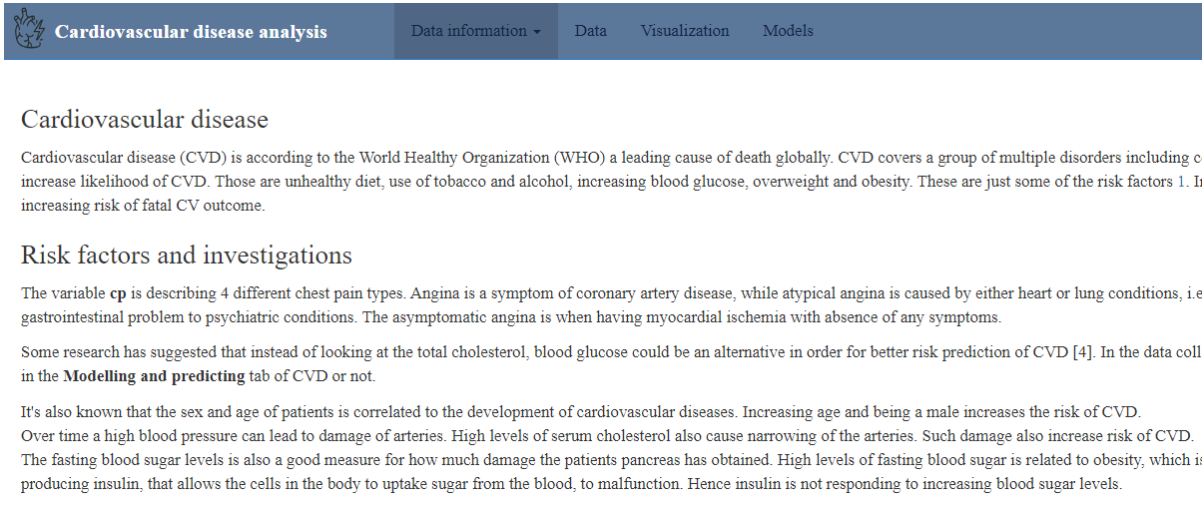
Data information
About CVD

Slide 12
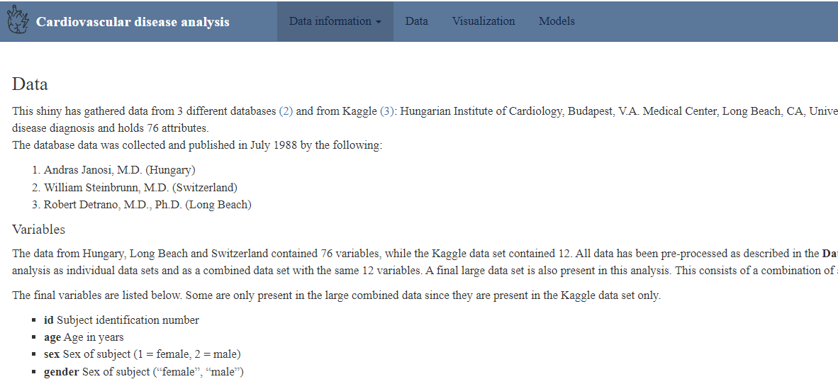
Data information
The data

Slide 13
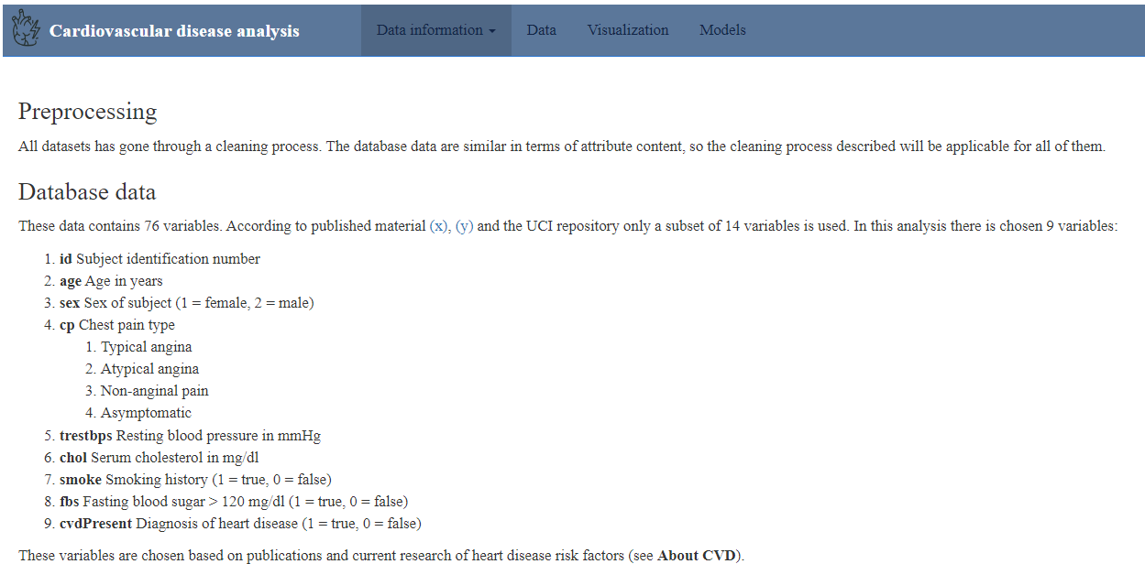
Data information
Pre-processing

Slide 14
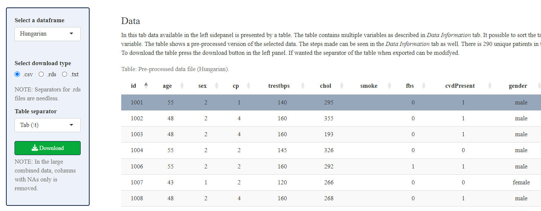
Data tab

Slide 15
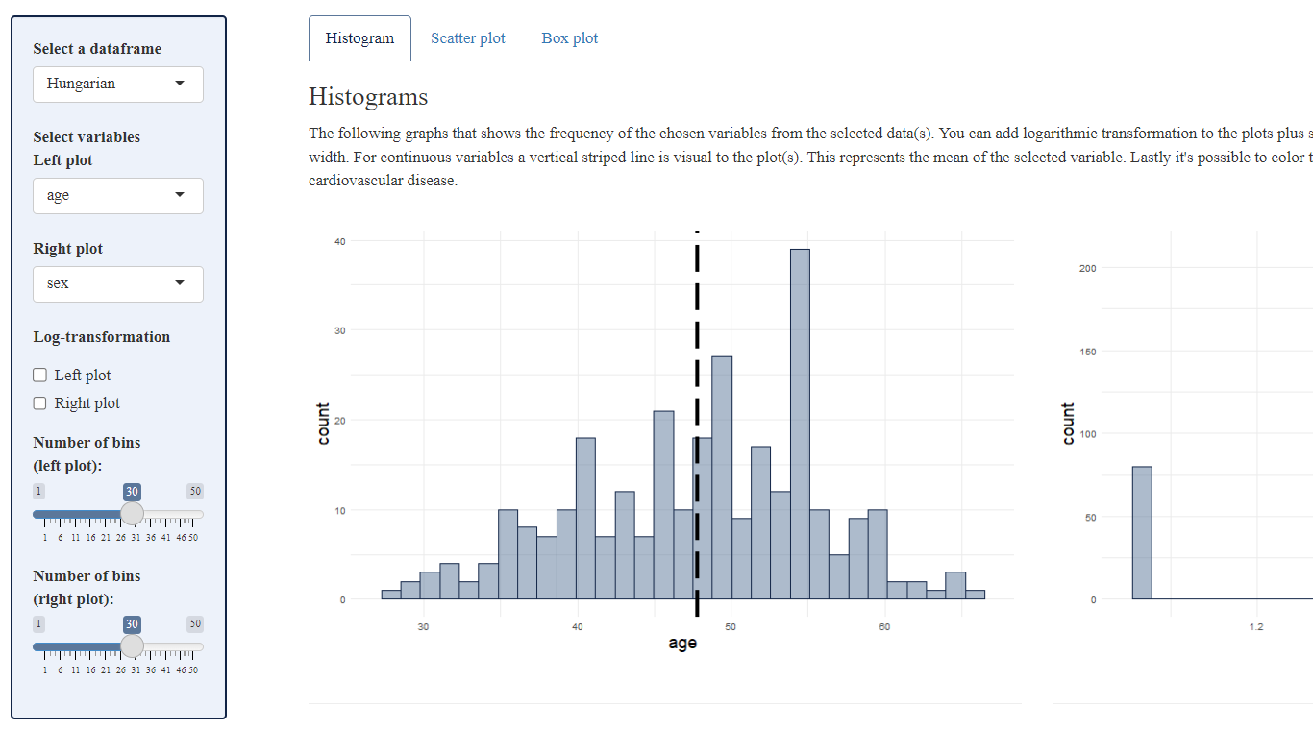
Visualization tab

Slide 16
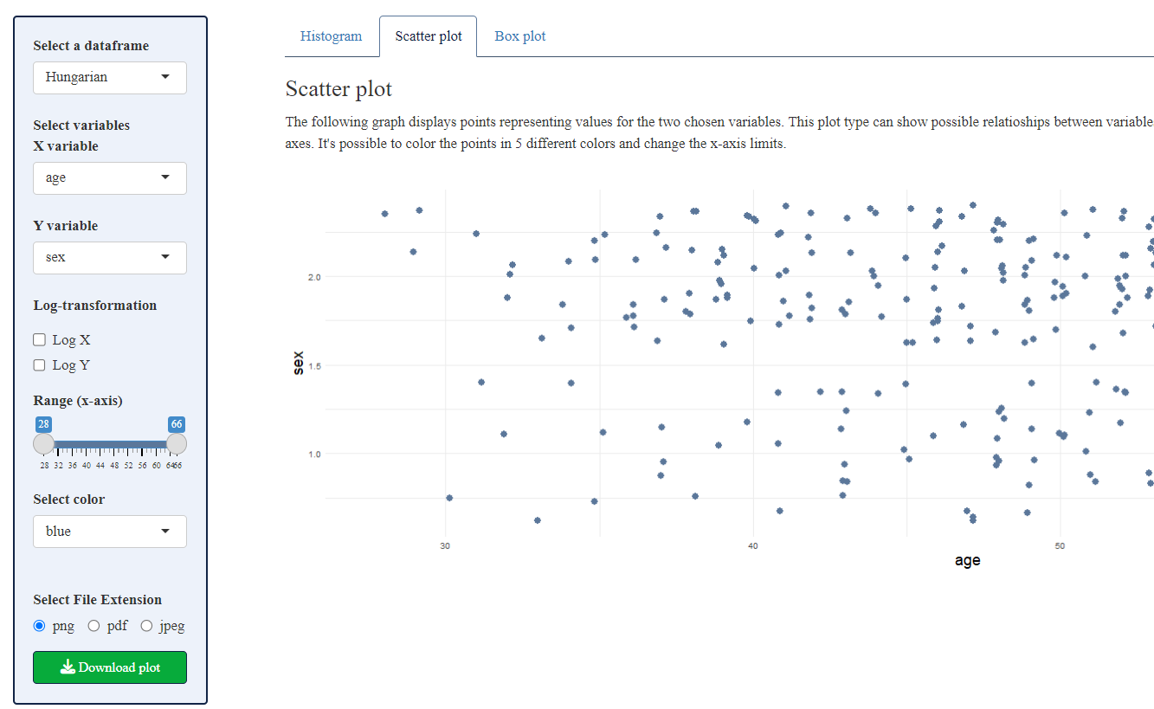
Visualization tab

Slide 17
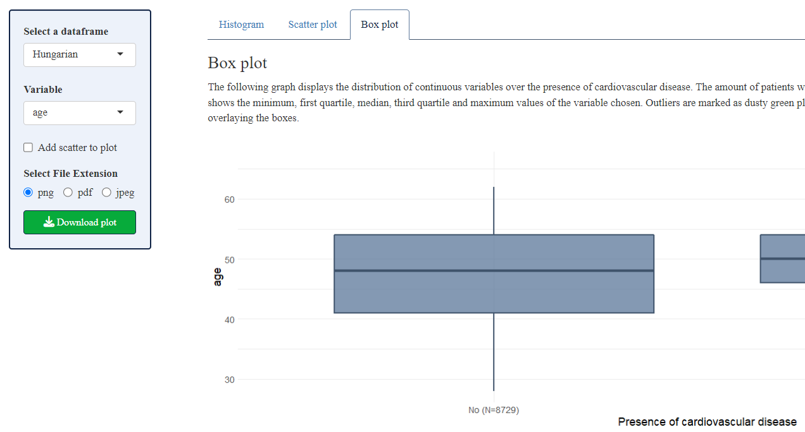
Visualization tab

Slide 18
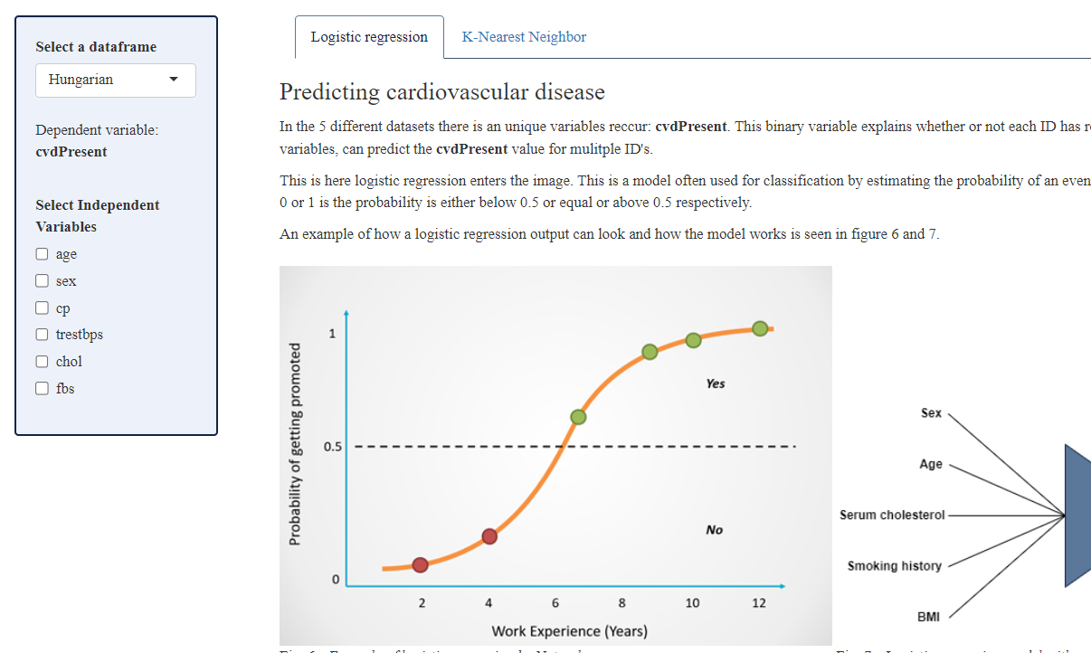
Models – logistic regression

Slide 19
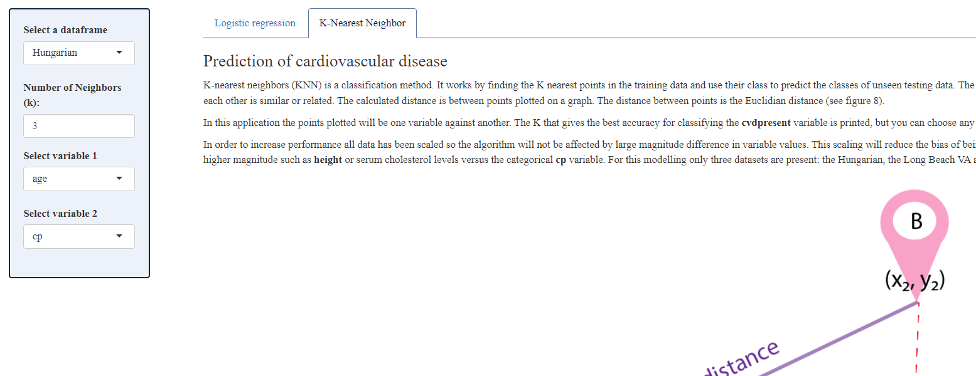
Models – K-Nearest Neighbors

Slide 20
References
https://archive.ics.uci.edu/dataset/45/heart+disease
https://www.sciencedirect.com/science/article/abs/pii/0002914989905249
https://www.who.int/health-topics/cardiovascular-diseases#tab=tab_1
https://pubmed.ncbi.nlm.nih.gov/28260748/
https://www.cdc.gov/bloodpressure/about.htm
https://www.ncbi.nlm.nih.gov/pmc/articles/PMC7399440/
https://www.istockphoto.com/vector/heart-attack-line-icon-gm1322482784-408434124 (Credit: Kadirkaba)
Notes:
Fasting blood sugar is increased in obese persons, which are more prone to CVD development.

